Slide 1
UE19CS390B – Capstone Project Phase – 2
Project Progress Review #1
Project Title : Automated Billing cart
Project ID : 75
Project Guide : Prajwala T.R
Project Team :
PES2U1G9CS198 Kuntal Gorai
PES2UG19CS346 S V S C Santosh
PES2UG19CS391 Skanda S
PES2UG19CS454 Vijay Murugan A S

Slide 2
Outline
Abstract and Scope of the Project
Capstone Project Phase – 1
Summary of work
Inferences drawn from Literature Survey
Expected Deliverables
Gantt chart

Slide 3
Abstract and Scope
Provide a basic introduction of the project and also an overview of scope it entails.
Set the context.

Slide 4
Summary of Work Done in Capstone Project Phase - 1
Provide summary of Phase – 1.
Include the suggestions and improvements made.

Slide 5
Work Done So Far
List of tasks/Modules to be elaborated in discussion with the guide.

Slide 6
Expected Deliverables
List of tasks/Modules to be elaborated in discussion with the guide.

Slide 7
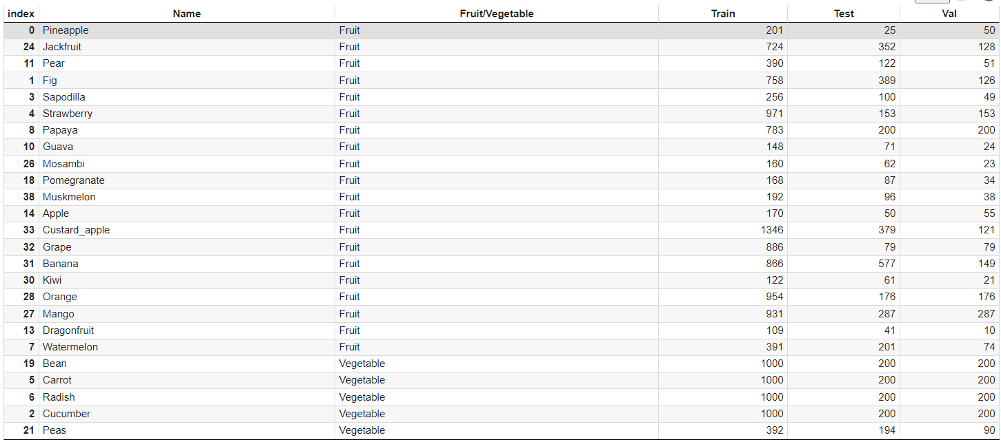
Expected Deliverables
Data Collection: Data Frame showing Necessary Information

Slide 8
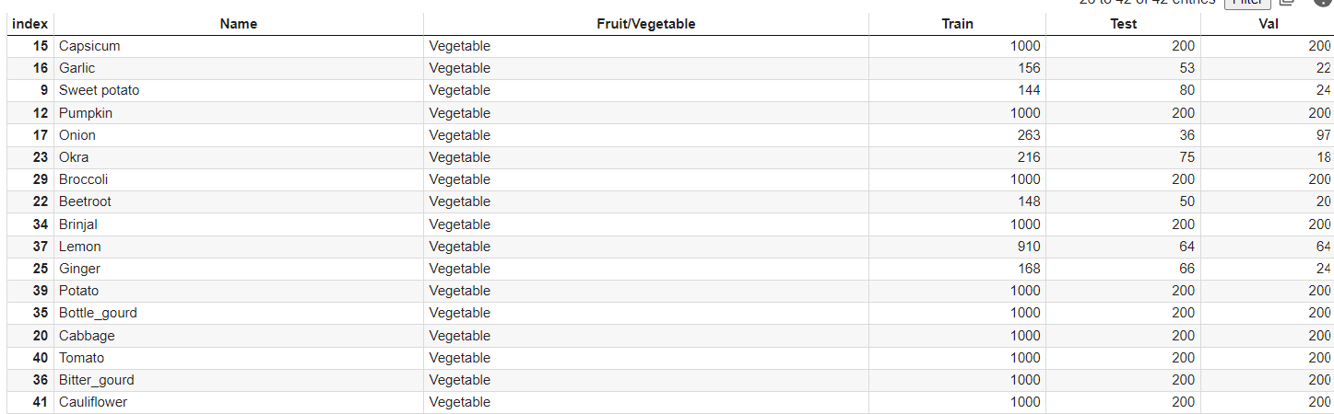
Expected Deliverables
Data Collection: Data Frame showing Necessary Information

Slide 9
Expected Deliverables
Data Preparation:
Data Input:
Data Pre-processing:

Slide 10
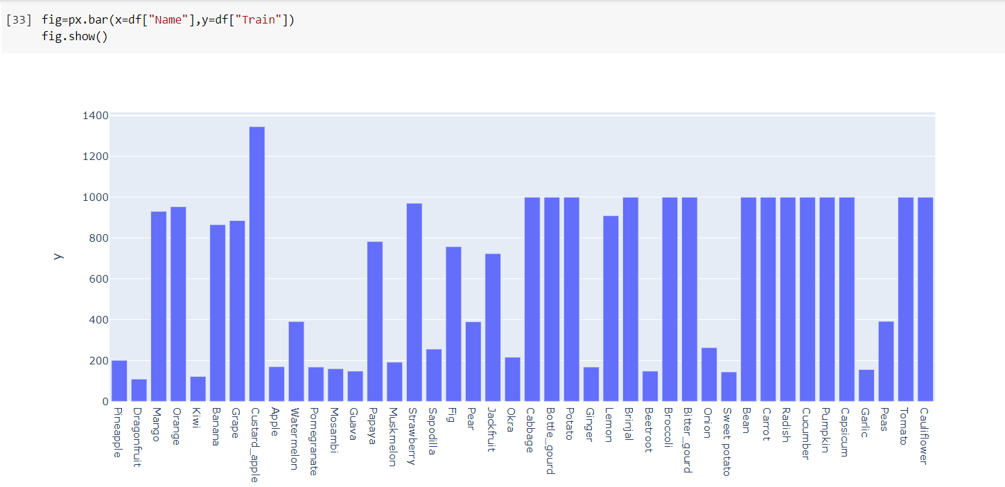
Expected Deliverables
Data Visualization: Train Images vs Class

Slide 11
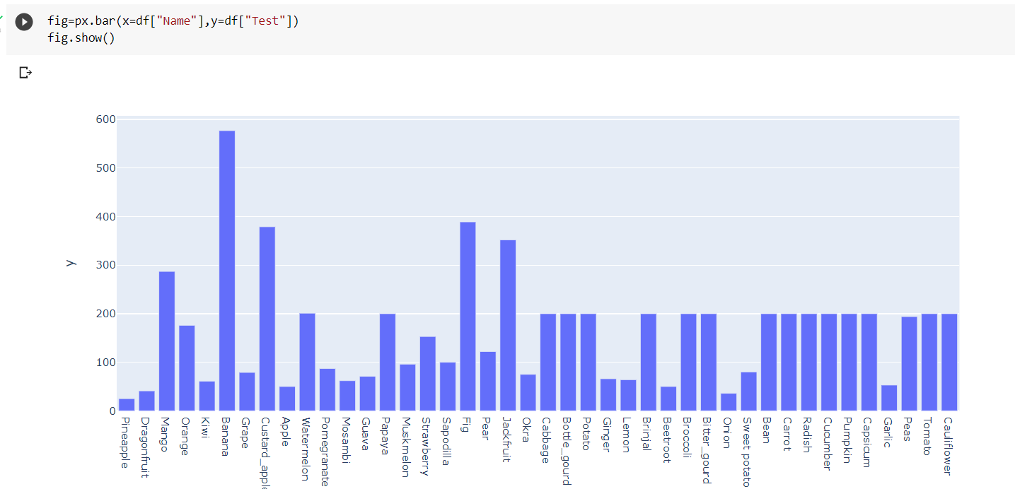
Expected Deliverables
Data Visualization: Test Images vs Class

Slide 12
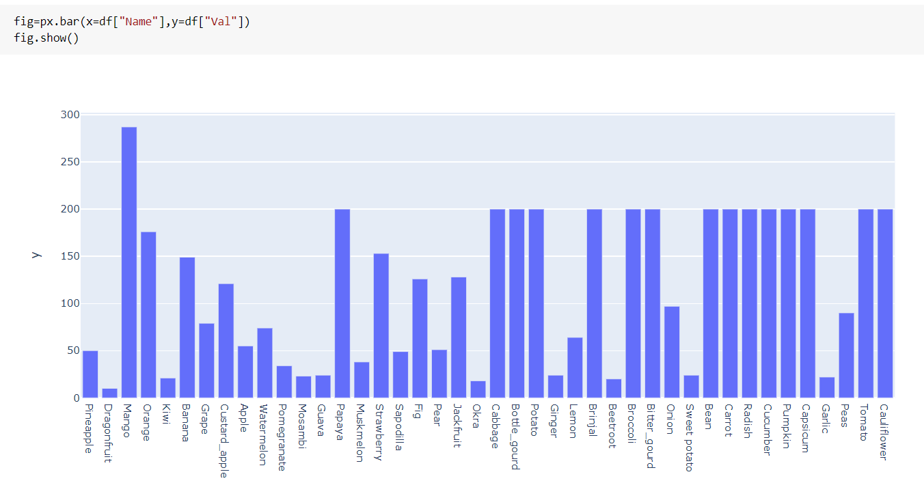
Expected Deliverables
Data Visualization: Validation Images vs Class

Slide 13
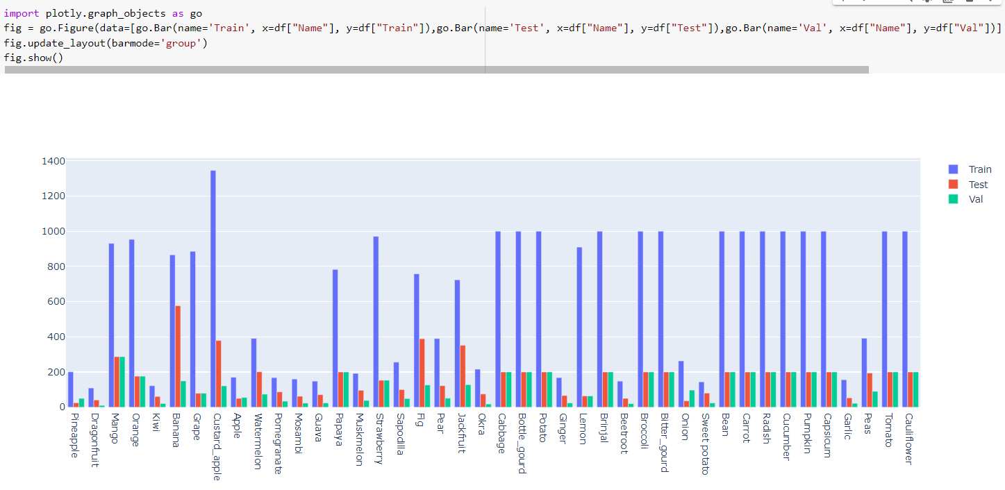
Expected Deliverables
Data Visualization: All Images vs Class

Slide 14
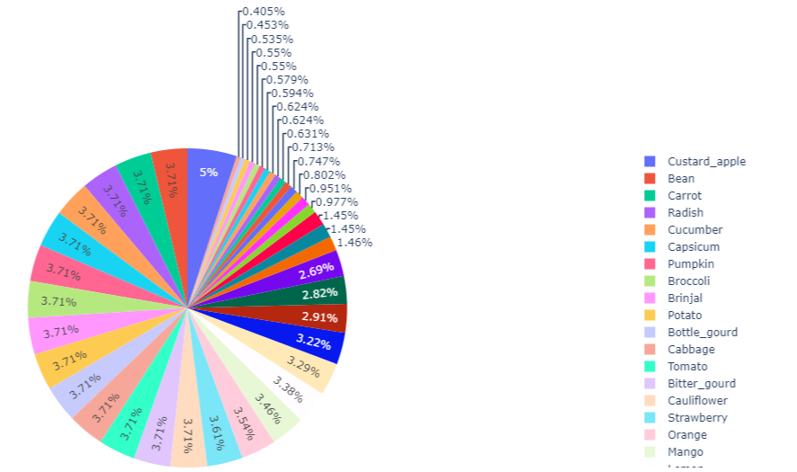
Expected Deliverables
Data Visualization: Percentage of Classes

Slide 15
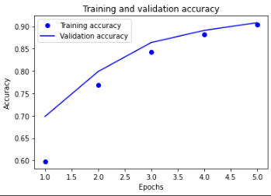
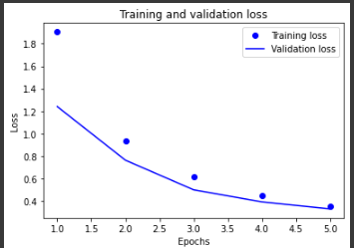
Expected Deliverables
Data Visualization:
Training and Validation Accuracy
Training and Validation Loss

Slide 16
Expected Deliverables
Data Interpretation:
Storage :

Slide 17
Expected Deliverables
3. Tabulate the individual contribution of the team members with the following
Tasks/Modules assigned
Development (no. of lines of code & time spent)

Slide 18
Expected Deliverables
List the SDK / API / Model / Jar/ DLL / Tools / Technologies used – Open-Source/ Licensed.
Testing for the module that is completed.

Slide 19
Expected Deliverables
Demonstration and Result of modules completed.
Tabulate the timeline for all the tasks/modules.

Slide 20
References
Provide references pertaining to your research according to IEEE format.
Example:
G. Eason, B. Noble, and I. N. Sneddon, “On certain integrals of Lipschitz-Hankel type involving products of Bessel functions,” Phil. Trans. Roy. Soc. London, vol. A247, pp. 529–551, April 1955. (references)

Slide 21
Thank You

